Slide 1
VIC market 98

Slide 2
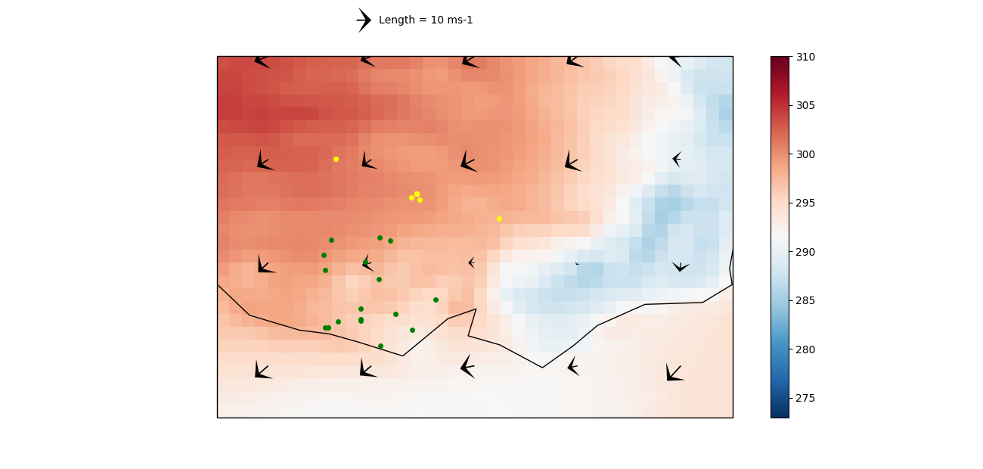
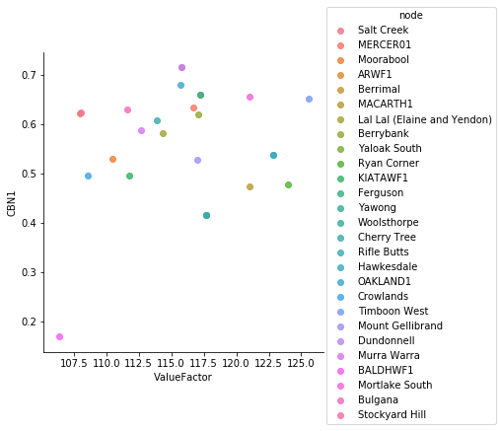
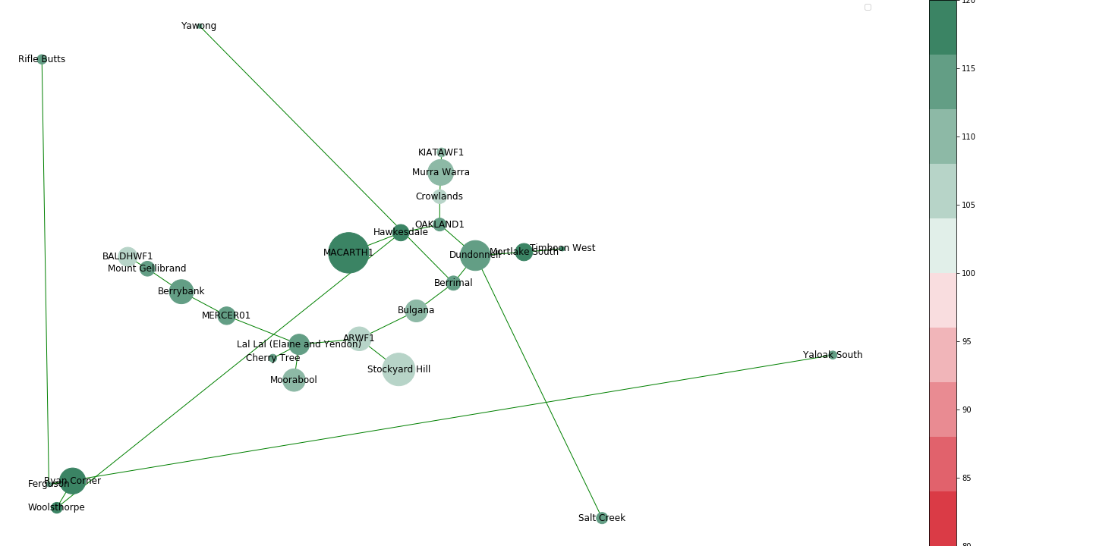
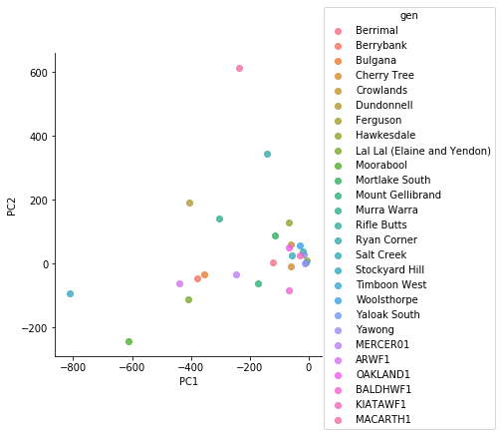
Time:2013-01-03T19:30:00.000000000, Price 172.57 $/MWh

Slide 3

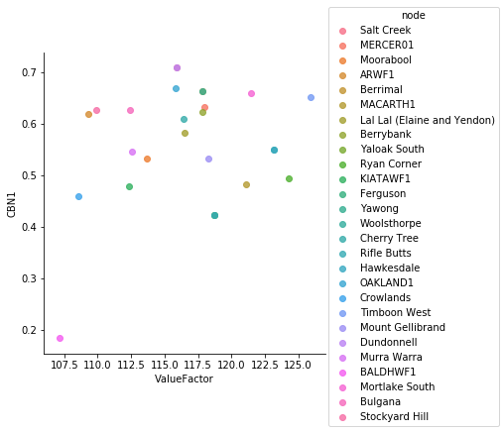
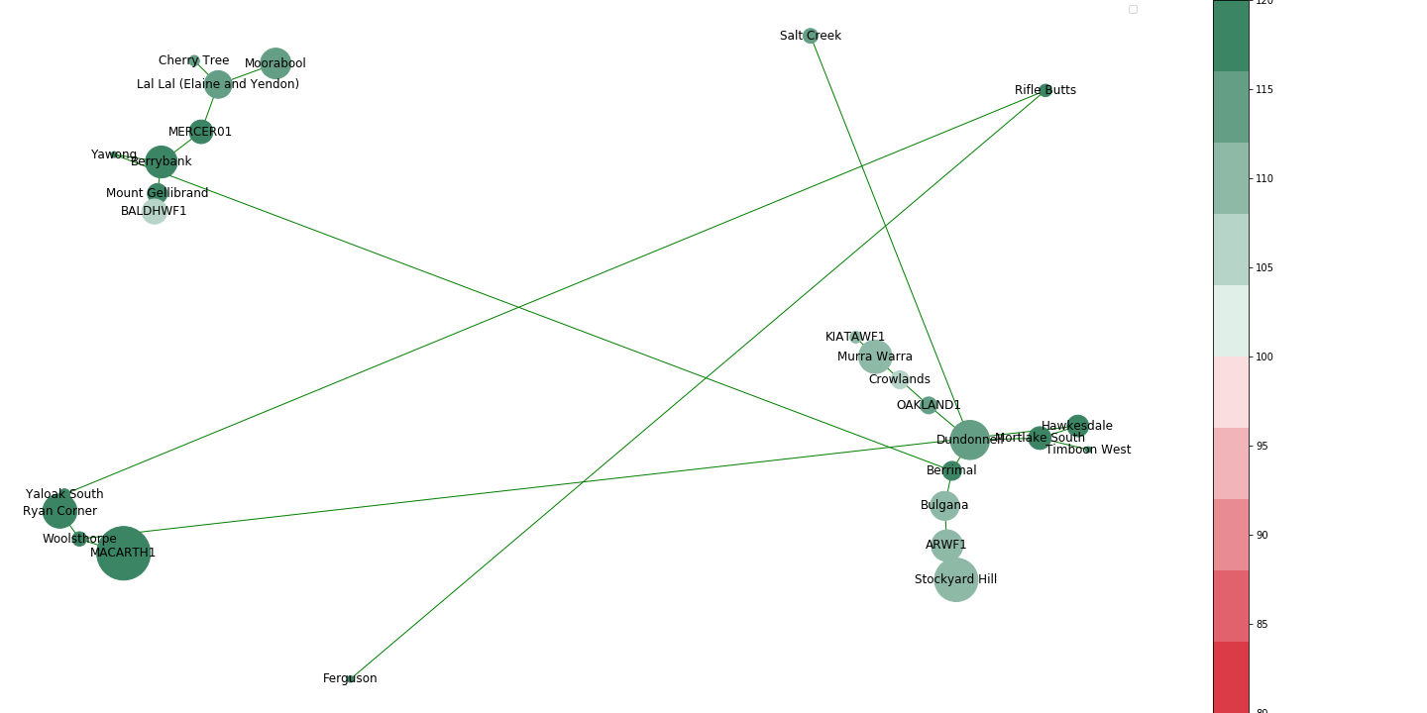
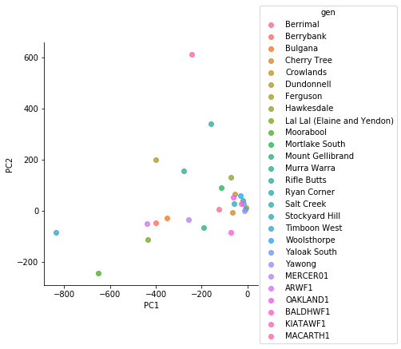
Time:2013-01-04T13:00:00.000000000, Price 186.92 $/MWh

Slide 4
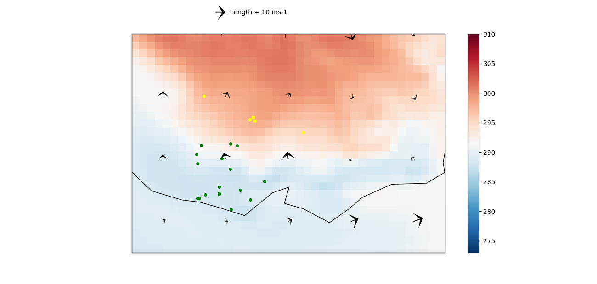
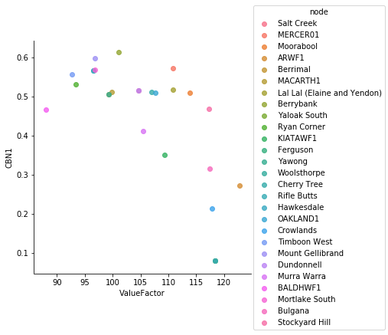
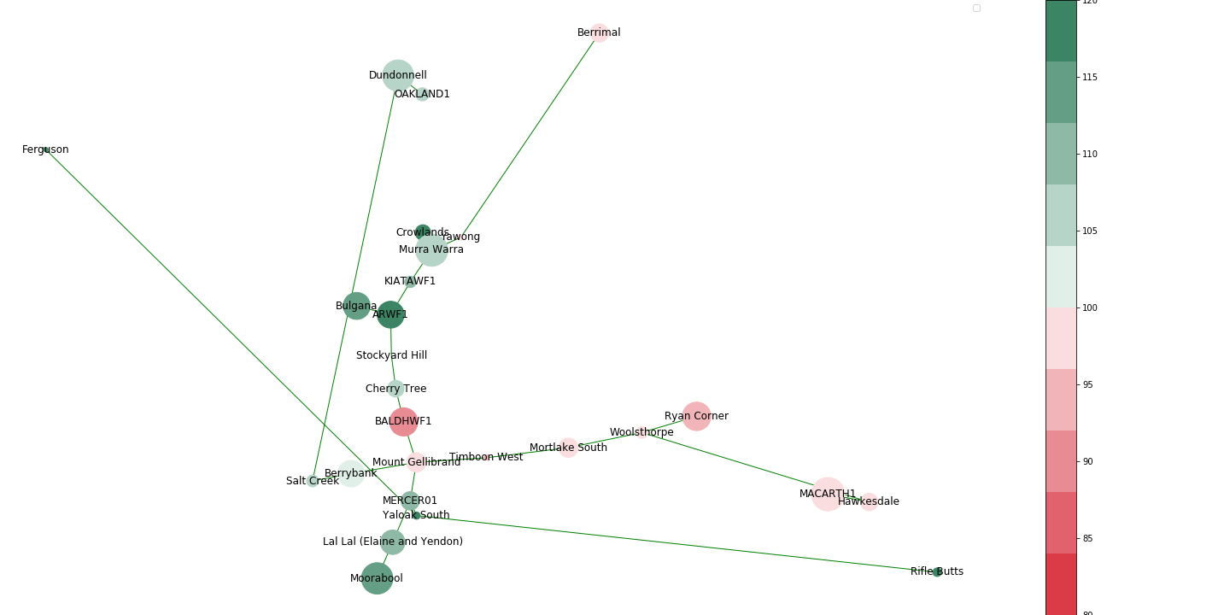
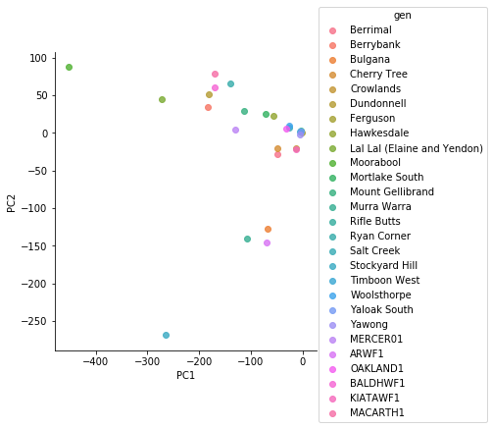
Time:2013-01-04T14:30:00.000000000, Price 1408.92 $/MWh

Slide 5
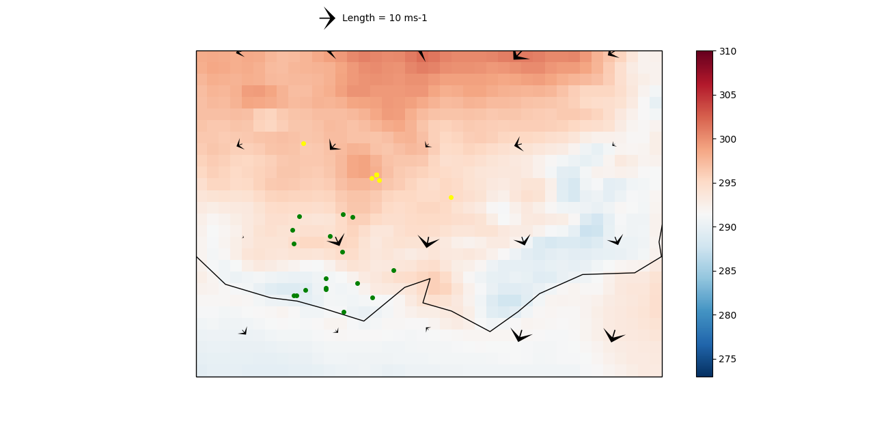
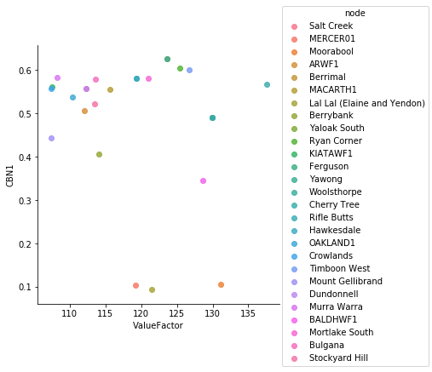
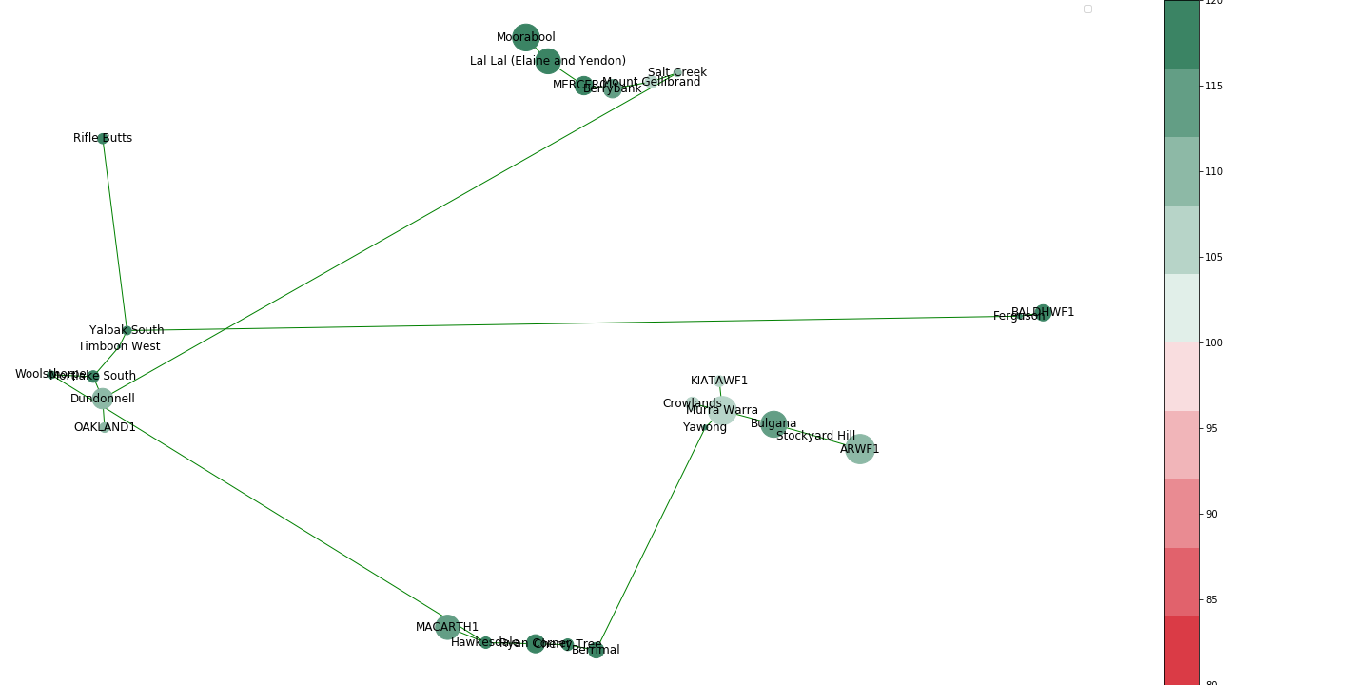
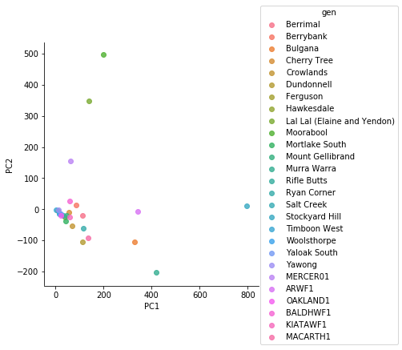
Time:2013-01-04T15:00:00.000000000, Price 2199.91 $/MWh

Slide 6
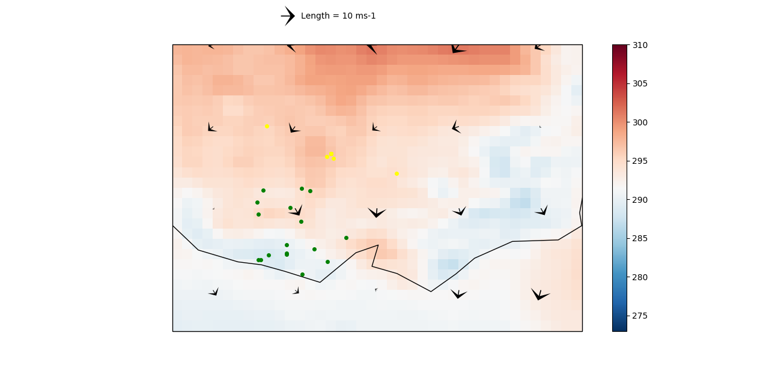
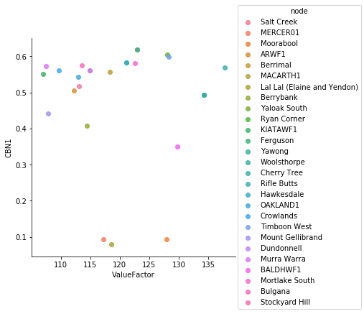
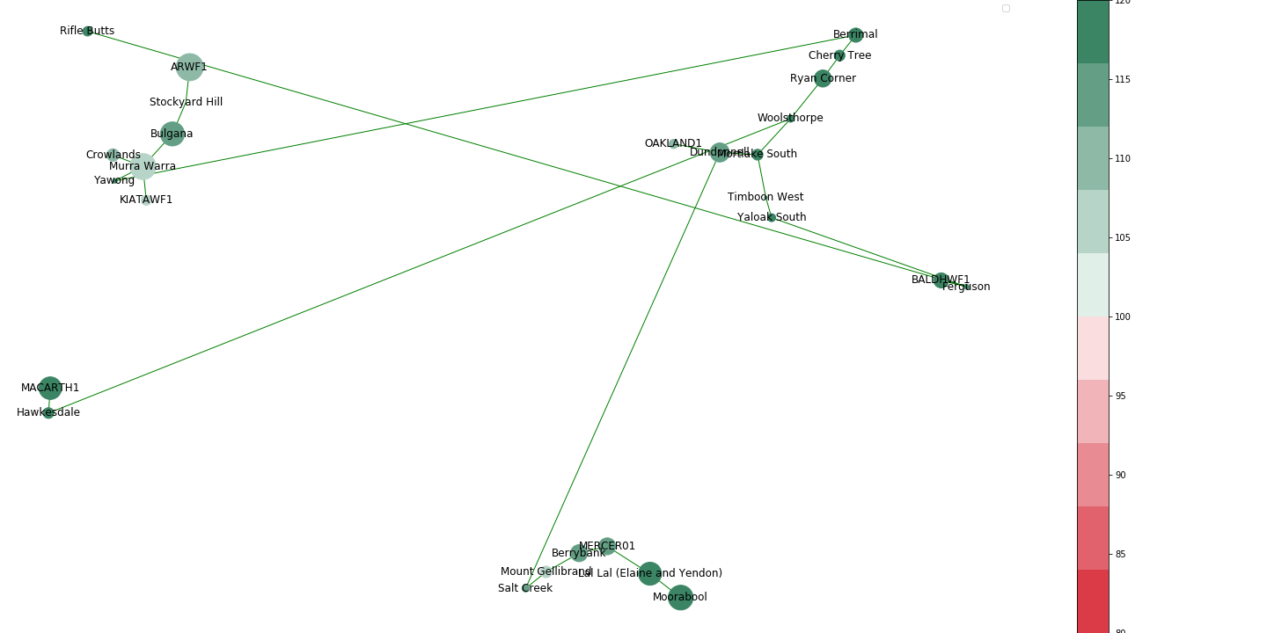

Time:2013-01-04T16:00:00.000000000, Price 2319.05 $/MWh

Slide 7
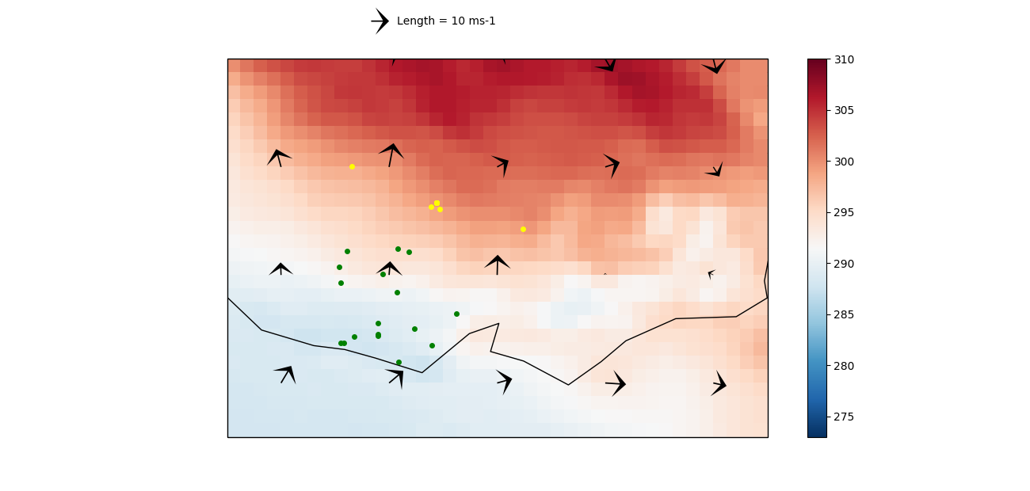
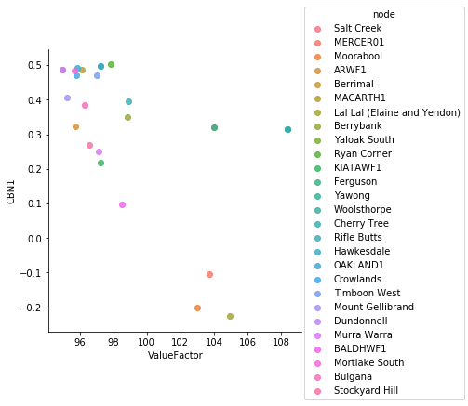
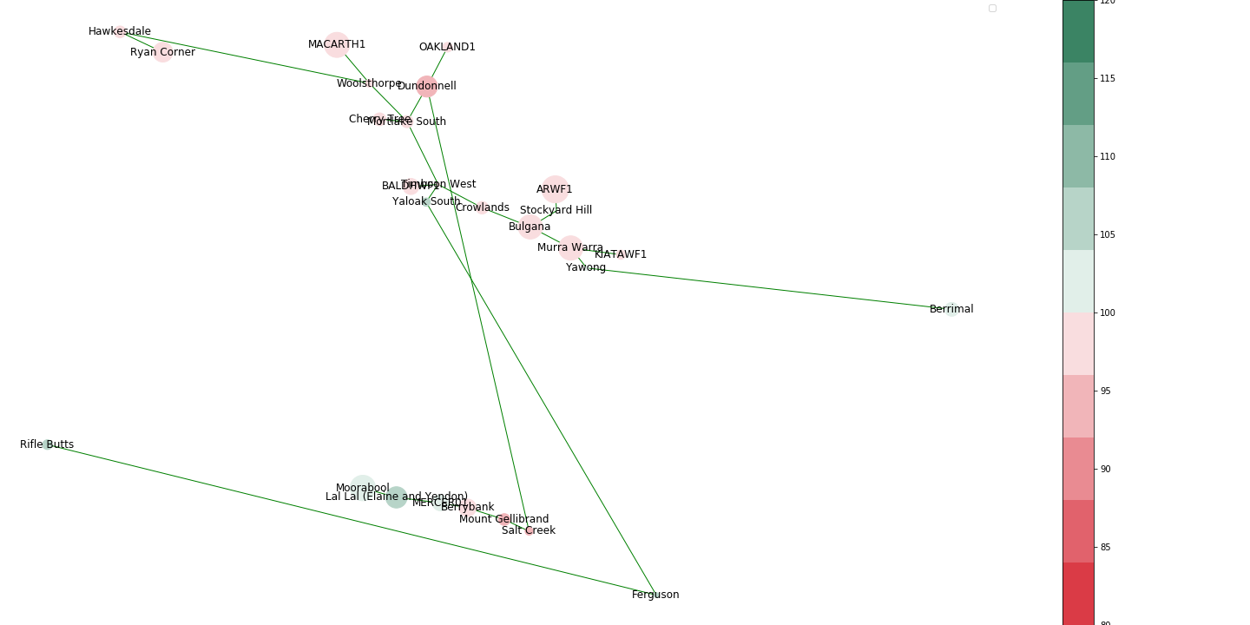
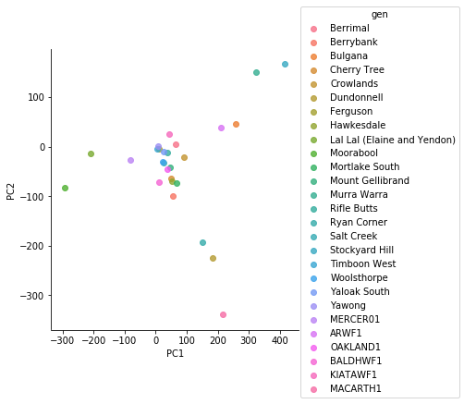
Time:2013-01-04T16:30:00.000000000, Price 4281.9 $/MWh

Slide 8
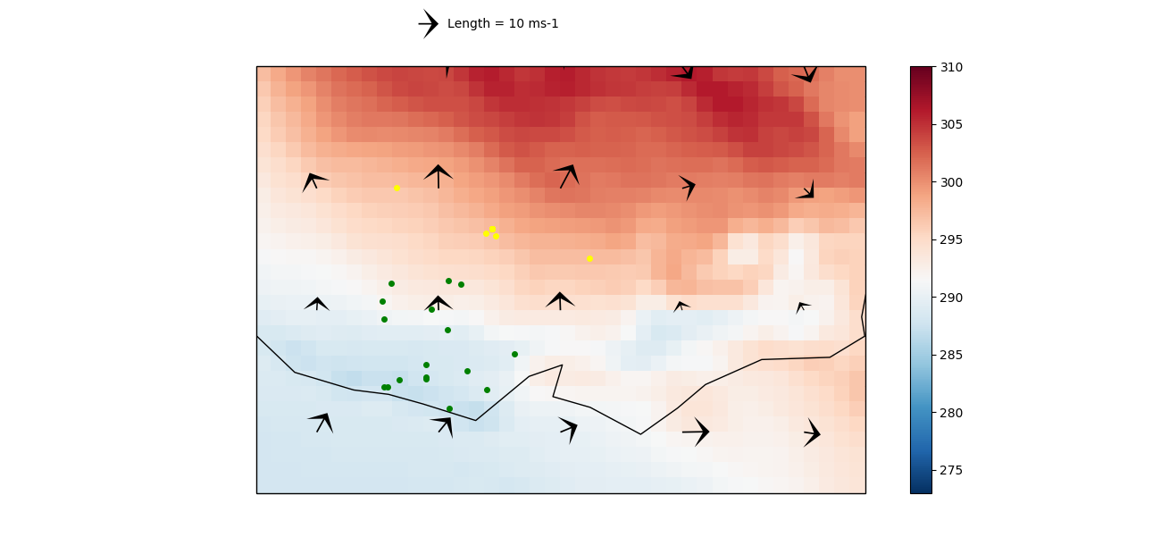
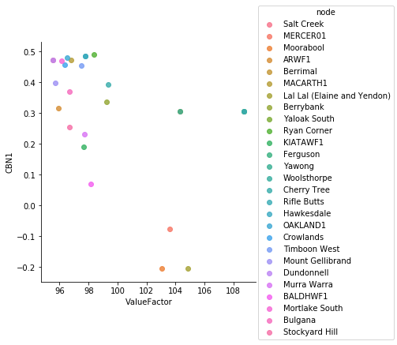
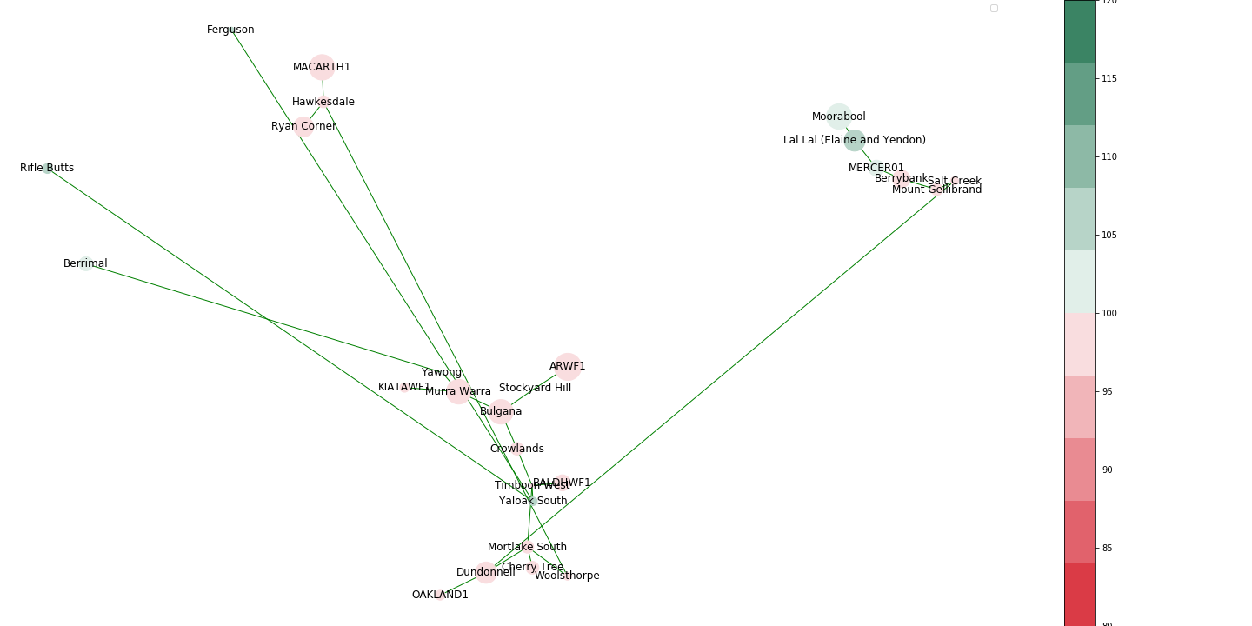
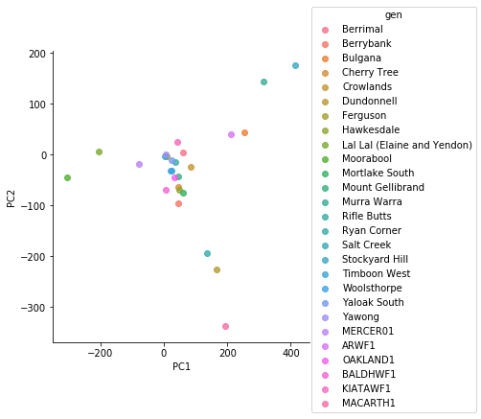
Time:2013-01-04T17:00:00.000000000, Price 302.47 $/MWh

Slide 9
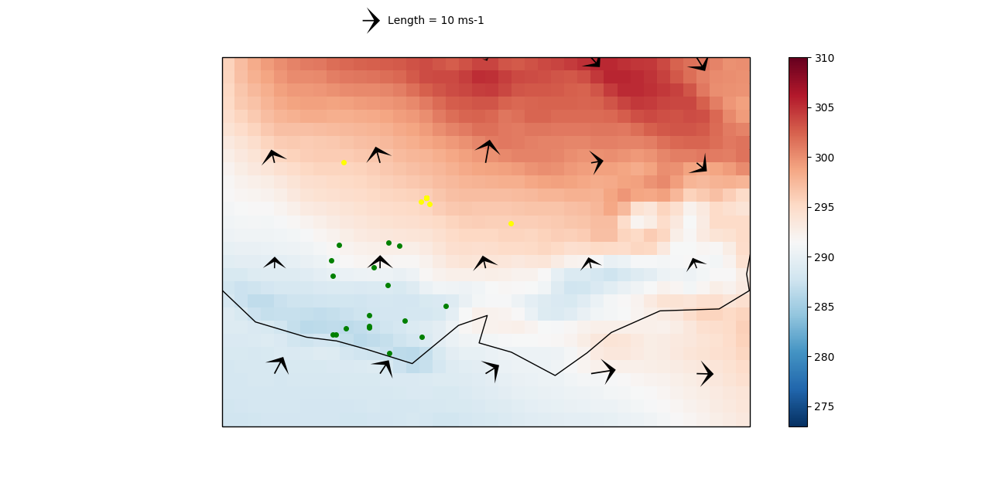
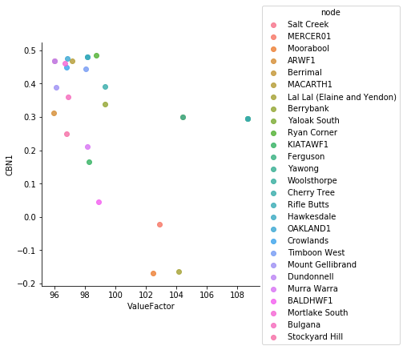
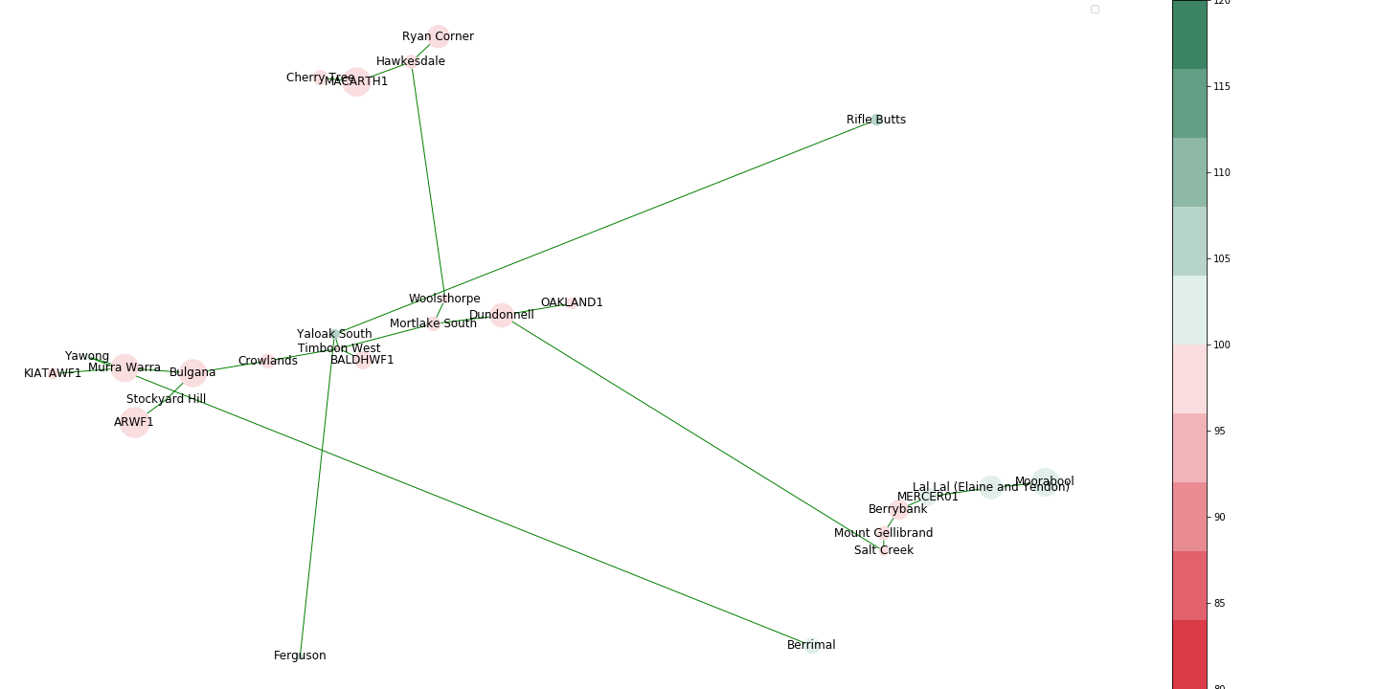
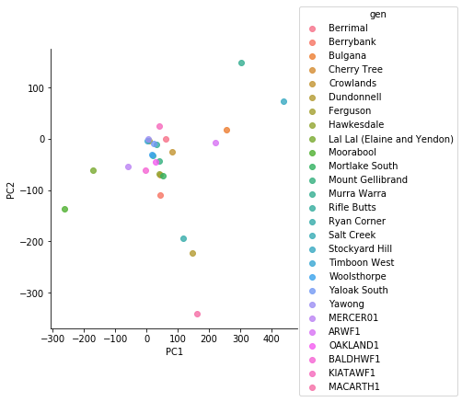
Time:2013-01-24T16:00:00.000000000, Price 234.13 $/MWh

Slide 10
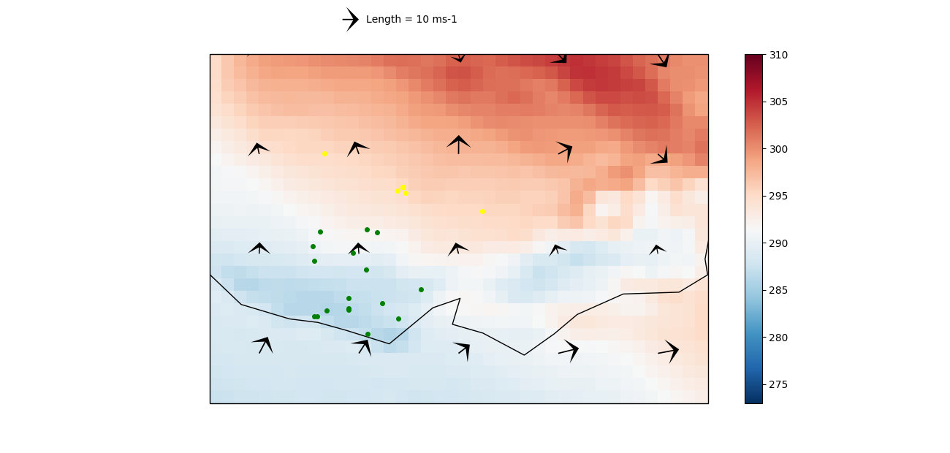
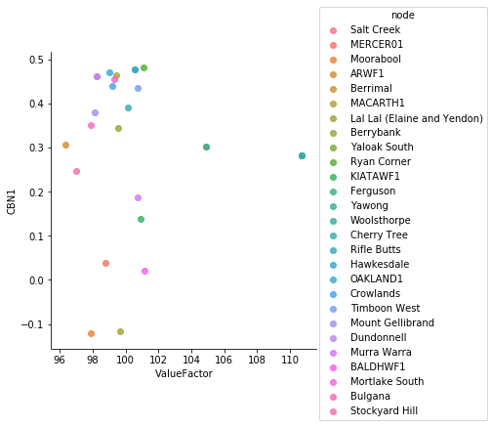
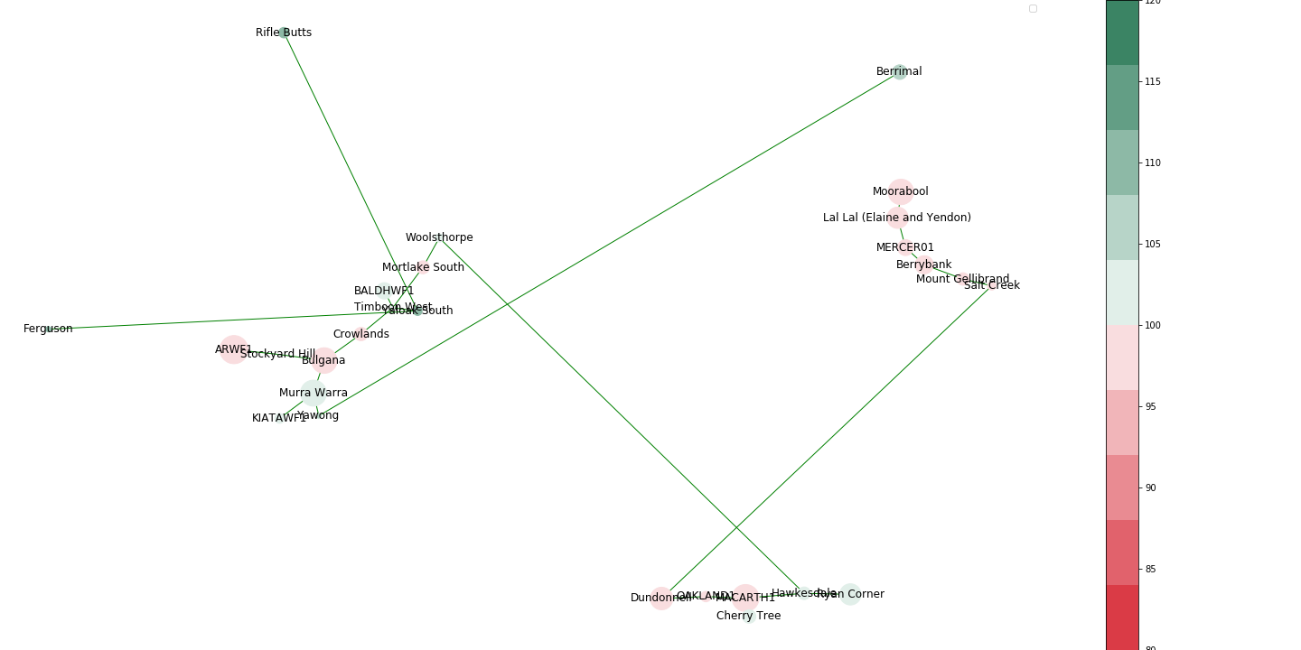
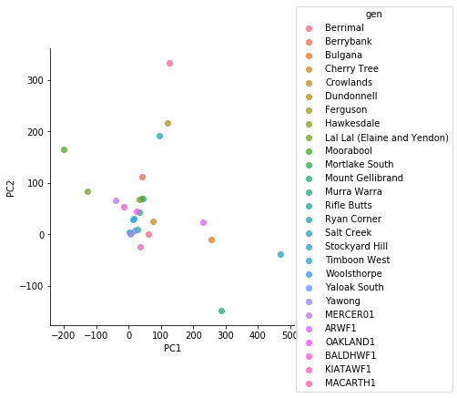
Time:2013-01-24T17:00:00.000000000, Price 172.95 $/MWh

Slide 11
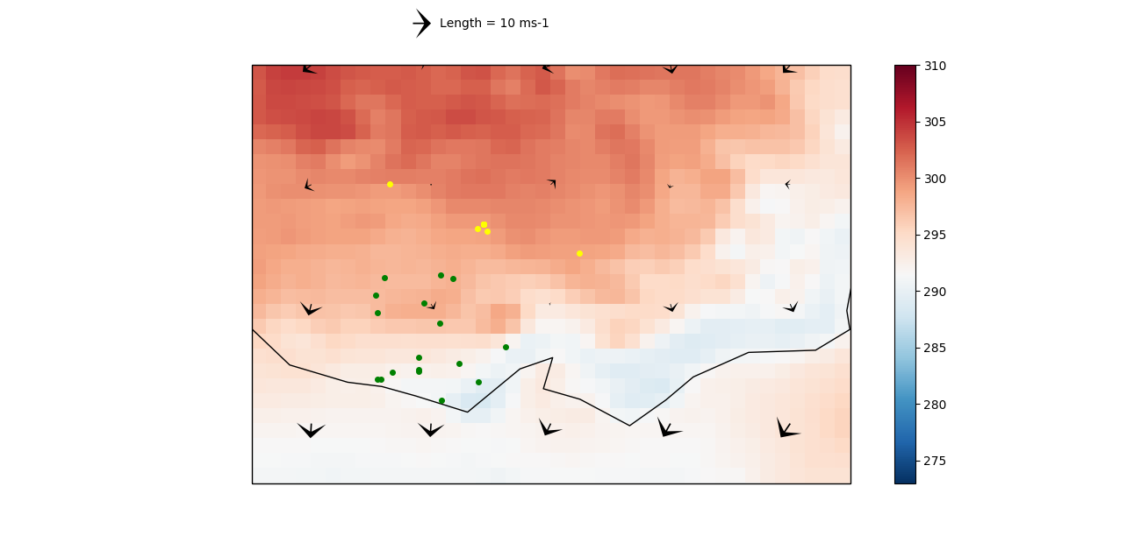
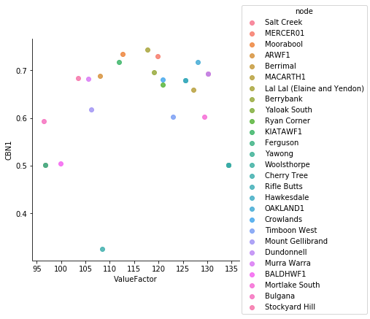
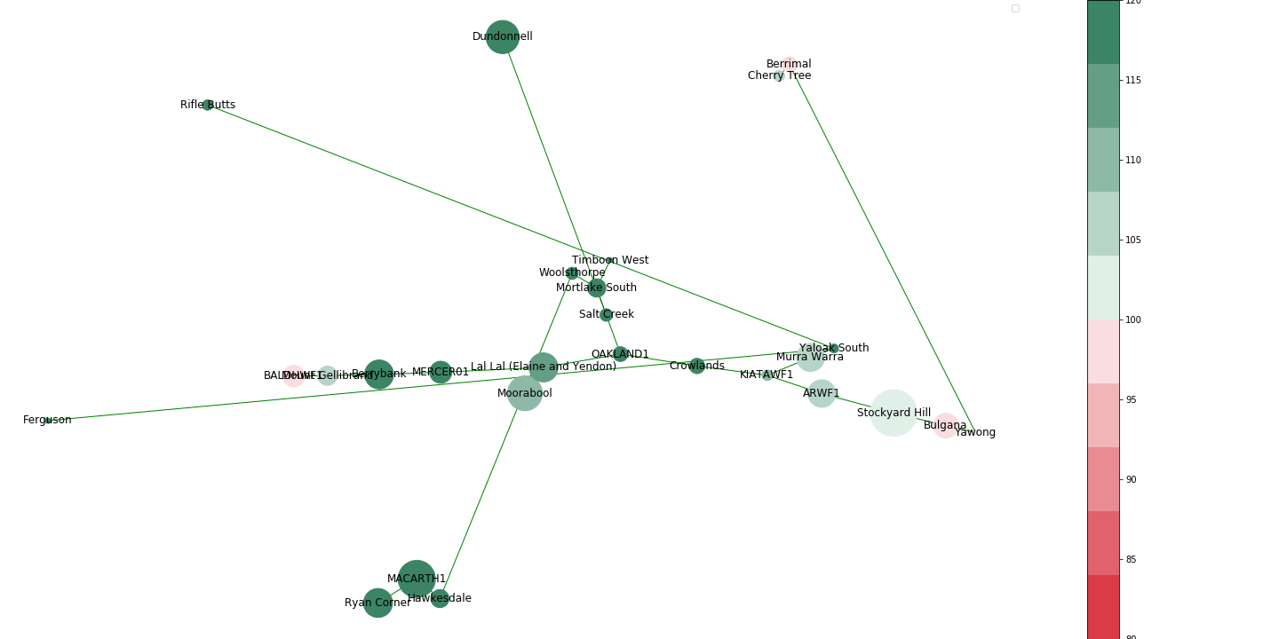
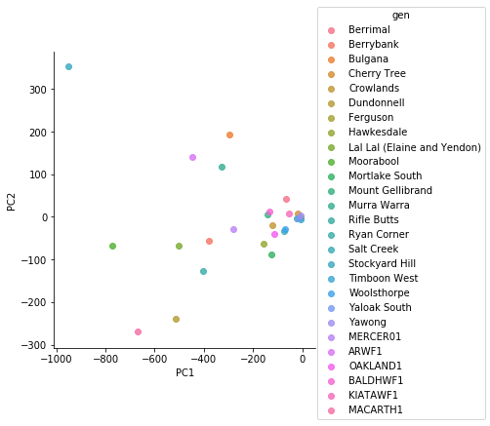
Time:2013-02-15T15:30:00.000000000, Price 205.51 $/MWh

Slide 12
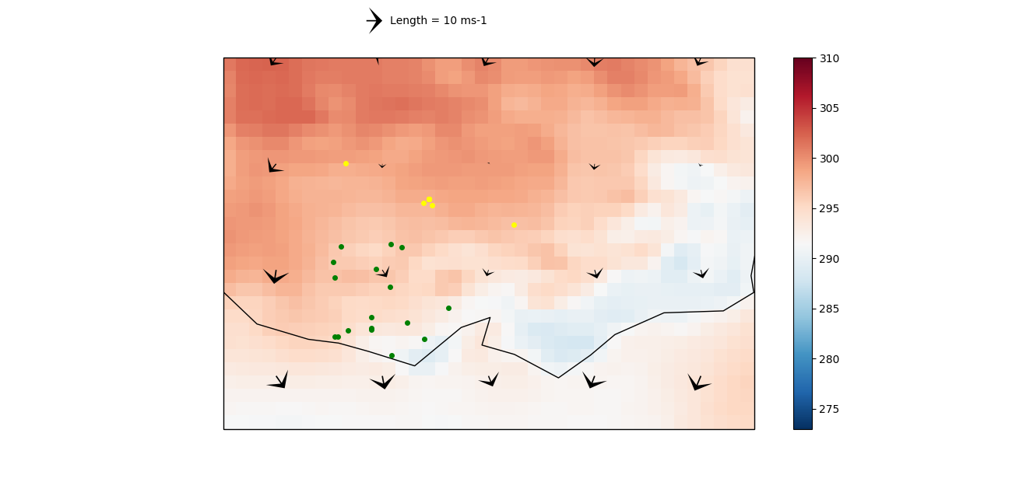
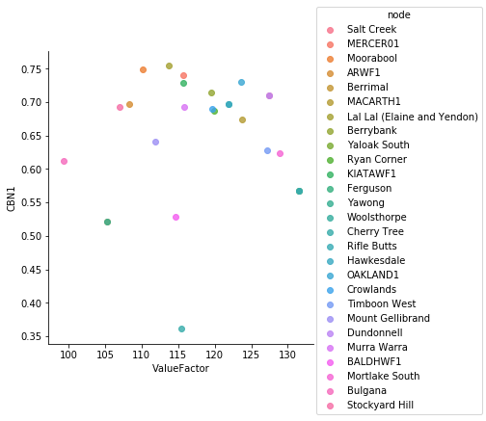
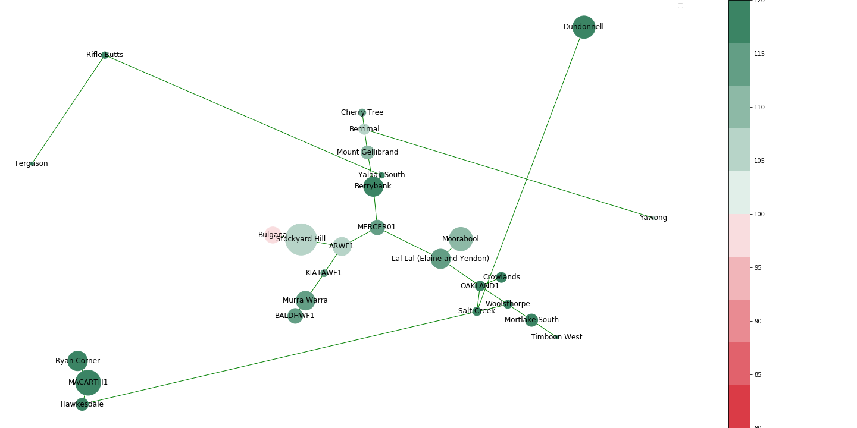
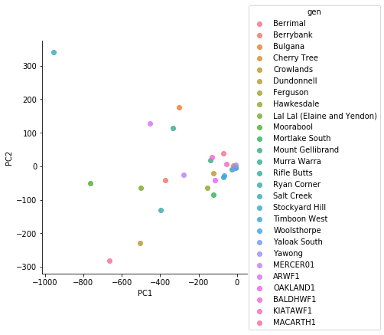
Time:2013-02-18T14:30:00.000000000, Price 187.85 $/MWh

Slide 13
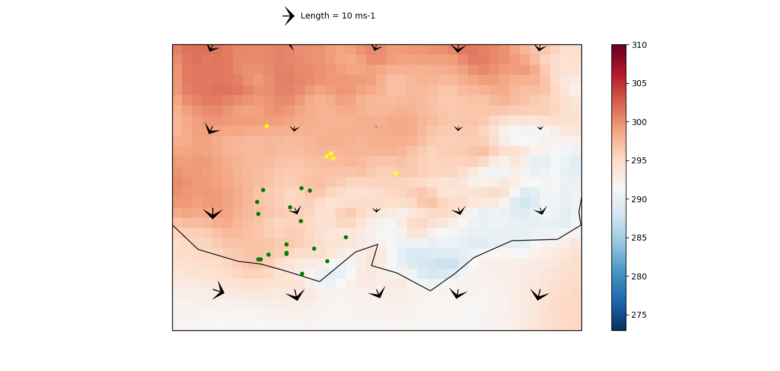
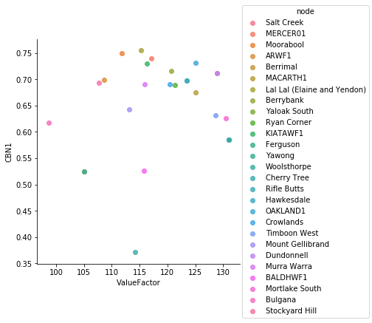
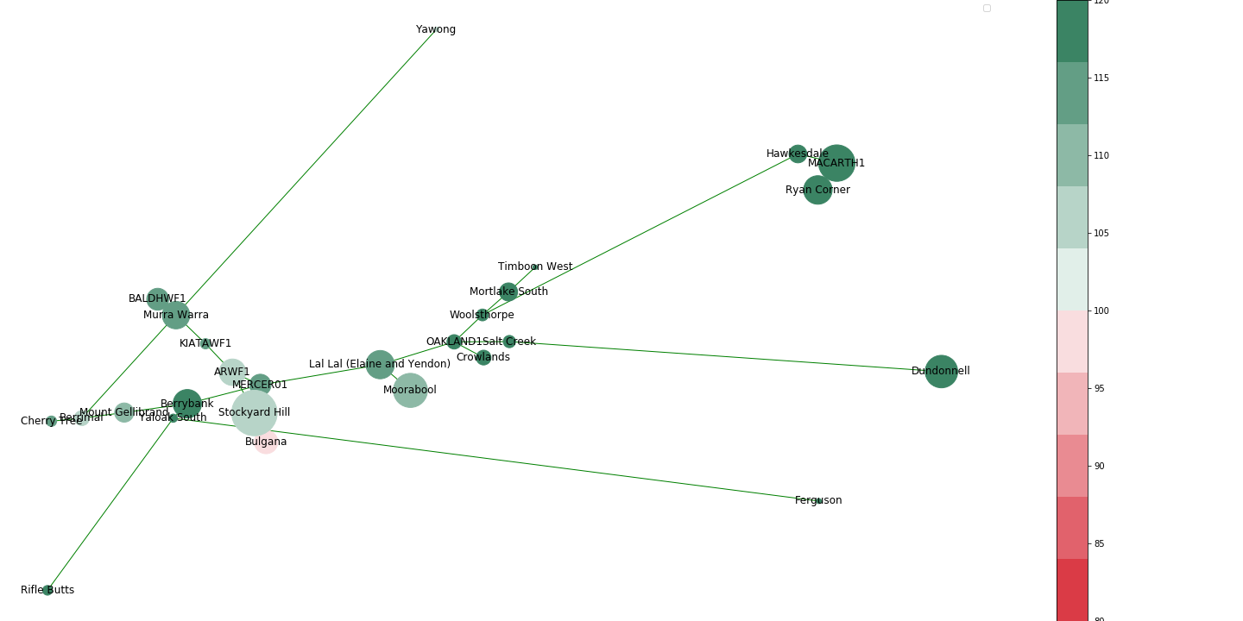
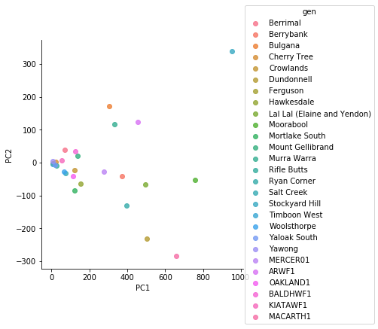
Time:2013-02-18T15:30:00.000000000, Price 179.81 $/MWh

Slide 14
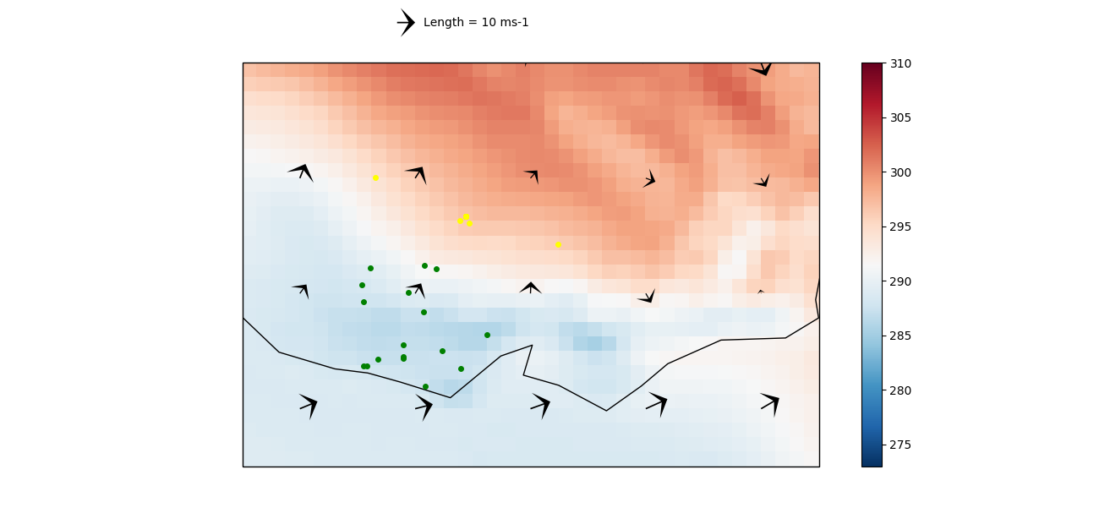
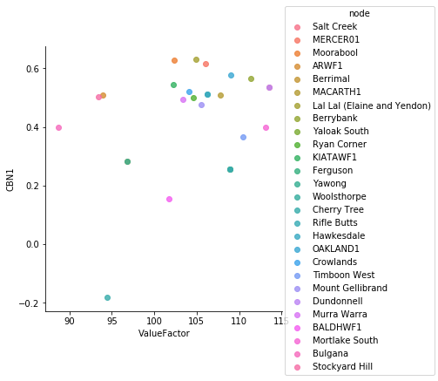
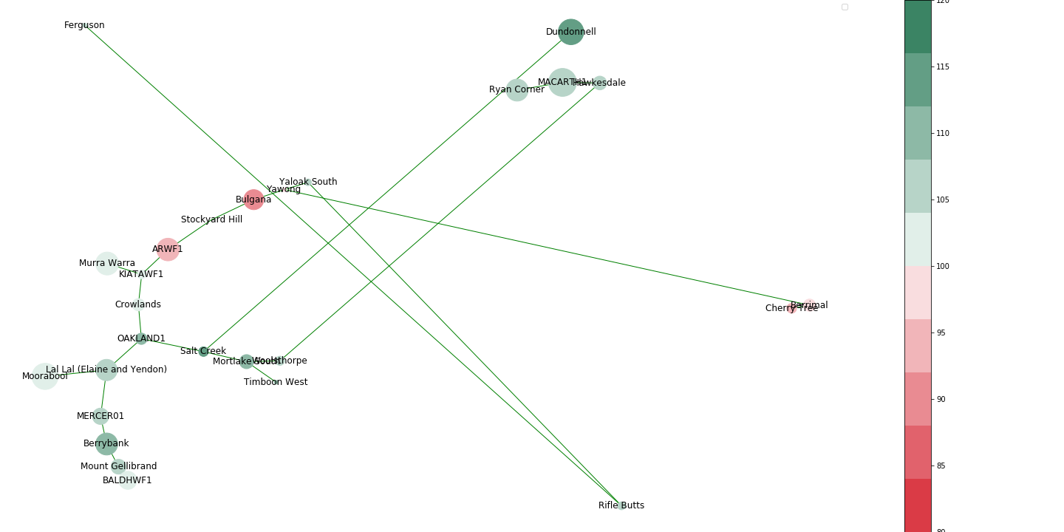
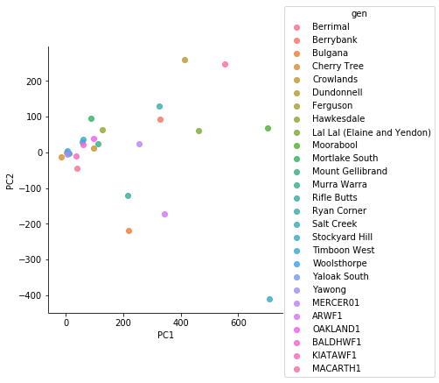
Time:2013-02-18T16:00:00.000000000, Price 502.64 $/MWh

Slide 15




Time:2013-02-18T16:30:00.000000000, Price 957.53 $/MWh

Slide 16




Time:2013-02-18T17:00:00.000000000, Price 1936.52 $/MWh

Slide 17




Time:2013-03-05T13:30:00.000000000, Price 158.73 $/MWh

Slide 18




Time:2013-03-05T15:30:00.000000000, Price 218.17 $/MWh

Slide 19




Time:2013-03-05T16:30:00.000000000, Price 200.26 $/MWh

Slide 20




Time:2013-03-07T16:00:00.000000000, Price 174.34 $/MWh

Slide 21




Time:2013-03-08T15:30:00.000000000, Price 804.14 $/MWh

Slide 22




Time:2013-03-12T14:30:00.000000000, Price 2138.88 $/MWh

Slide 23




Time:2013-03-12T16:30:00.000000000, Price 239.35 $/MWh

Slide 24




Time:2013-05-22T07:00:00.000000000, Price 166.37 $/MWh

Slide 25




Time:2013-05-27T00:00:00.000000000, Price 210.9 $/MWh

Slide 26




Time:2013-05-27T08:30:00.000000000, Price 165.27 $/MWh

Slide 27




Time:2013-05-27T18:30:00.000000000, Price 187.63 $/MWh

Slide 28




Time:2013-05-28T18:00:00.000000000, Price 1426.21 $/MWh

Slide 29




Time:2013-06-18T08:00:00.000000000, Price 167.96 $/MWh

Slide 30




Time:2013-06-18T08:30:00.000000000, Price 199.12 $/MWh

Slide 31




Time:2013-06-18T14:00:00.000000000, Price 158.26 $/MWh

Slide 32




Time:2013-06-20T08:00:00.000000000, Price 165.04 $/MWh

Slide 33




Time:2013-06-20T08:30:00.000000000, Price 194.56 $/MWh

Slide 34




Time:2013-06-20T09:00:00.000000000, Price 157.93 $/MWh

Slide 35




Time:2013-06-20T09:30:00.000000000, Price 167.83 $/MWh

Slide 36




Time:2013-06-20T16:00:00.000000000, Price 166.91 $/MWh

Slide 37




Time:2013-06-21T10:00:00.000000000, Price 2026.38 $/MWh

Slide 38




Time:2013-06-21T11:00:00.000000000, Price 1937.34 $/MWh

Slide 39




Time:2013-06-21T14:00:00.000000000, Price 160.63 $/MWh

Slide 40




Time:2013-06-21T14:30:00.000000000, Price 150.88 $/MWh

Slide 41




Time:2013-06-22T18:00:00.000000000, Price 163.76 $/MWh

Slide 42




Time:2013-07-09T09:30:00.000000000, Price 175.59 $/MWh

Slide 43




Time:2013-08-20T19:00:00.000000000, Price 151.99 $/MWh

Slide 44




Time:2013-12-02T15:30:00.000000000, Price 224.38 $/MWh

Slide 45




Time:2013-12-02T16:00:00.000000000, Price 443.1 $/MWh

Slide 46




Time:2013-12-19T16:00:00.000000000, Price 789.86 $/MWh

Slide 47




Time:2013-12-19T16:30:00.000000000, Price 1474.83 $/MWh

Slide 48




Time:2013-12-19T17:30:00.000000000, Price 3667.01 $/MWh

Slide 49




Time:2013-12-19T18:00:00.000000000, Price 467.74 $/MWh

Slide 50




Time:2014-01-14T10:30:00.000000000, Price 235.91 $/MWh

Slide 51




Time:2014-01-14T11:00:00.000000000, Price 194.29 $/MWh

Slide 52




Time:2014-01-14T14:00:00.000000000, Price 828.68 $/MWh

Slide 53




Time:2014-01-14T14:30:00.000000000, Price 161.1 $/MWh

Slide 54




Time:2014-01-14T16:00:00.000000000, Price 184.41 $/MWh

Slide 55




Time:2014-01-14T16:30:00.000000000, Price 215.25 $/MWh

Slide 56




Time:2014-01-14T17:00:00.000000000, Price 157.92 $/MWh

Slide 57




Time:2014-01-14T18:30:00.000000000, Price 1803.52 $/MWh

Slide 58




Time:2014-01-14T19:00:00.000000000, Price 1889.48 $/MWh

Slide 59




Time:2014-01-14T21:00:00.000000000, Price 211.88 $/MWh

Slide 60




Time:2014-01-14T21:30:00.000000000, Price 154.87 $/MWh

Slide 61




Time:2014-01-14T23:30:00.000000000, Price 160.29 $/MWh

Slide 62




Time:2014-01-15T07:00:00.000000000, Price 151.84 $/MWh

Slide 63




Time:2014-01-15T08:00:00.000000000, Price 176.89 $/MWh

Slide 64




Time:2014-01-15T08:30:00.000000000, Price 286.85 $/MWh

Slide 65




Time:2014-01-15T09:00:00.000000000, Price 278.78 $/MWh

Slide 66




Time:2014-01-15T09:30:00.000000000, Price 268.66 $/MWh

Slide 67




Time:2014-01-15T10:00:00.000000000, Price 293.11 $/MWh

Slide 68




Time:2014-01-15T10:30:00.000000000, Price 322.43 $/MWh

Slide 69




Time:2014-01-15T11:00:00.000000000, Price 378.55 $/MWh

Slide 70




Time:2014-01-15T11:30:00.000000000, Price 508.07 $/MWh

Slide 71




Time:2014-01-15T12:00:00.000000000, Price 435.29 $/MWh

Slide 72




Time:2014-01-15T12:30:00.000000000, Price 1188.78 $/MWh

Slide 73




Time:2014-01-15T13:00:00.000000000, Price 338.13 $/MWh

Slide 74




Time:2014-01-15T13:30:00.000000000, Price 2053.42 $/MWh

Slide 75




Time:2014-01-15T14:00:00.000000000, Price 3884.18 $/MWh

Slide 76




Time:2014-01-15T14:30:00.000000000, Price 1127.05 $/MWh

Slide 77




Time:2014-01-15T15:00:00.000000000, Price 202.64 $/MWh

Slide 78




Time:2014-01-15T15:30:00.000000000, Price 3330.9 $/MWh

Slide 79




Time:2014-01-15T16:00:00.000000000, Price 5972.27 $/MWh

Slide 80




Time:2014-01-15T16:30:00.000000000, Price 206.74 $/MWh

Slide 81




Time:2014-01-15T17:00:00.000000000, Price 311.31 $/MWh

Slide 82




Time:2014-01-15T20:30:00.000000000, Price 228.53 $/MWh

Slide 83




Time:2014-01-16T08:30:00.000000000, Price 238.76 $/MWh

Slide 84




Time:2014-01-16T10:00:00.000000000, Price 166.12 $/MWh

Slide 85




Time:2014-01-16T10:30:00.000000000, Price 171.98 $/MWh

Slide 86




Time:2014-01-16T11:00:00.000000000, Price 229.38 $/MWh

Slide 87




Time:2014-01-16T11:30:00.000000000, Price 251.82 $/MWh

Slide 88




Time:2014-01-16T12:00:00.000000000, Price 252.24 $/MWh

Slide 89




Time:2014-01-16T12:30:00.000000000, Price 204.39 $/MWh

Slide 90




Time:2014-01-16T13:00:00.000000000, Price 166.31 $/MWh

Slide 91




Time:2014-01-16T14:30:00.000000000, Price 206.68 $/MWh

Slide 92




Time:2014-01-16T15:00:00.000000000, Price 277.53 $/MWh

Slide 93




Time:2014-01-16T15:30:00.000000000, Price 400.47 $/MWh

Slide 94




Time:2014-01-16T16:00:00.000000000, Price 1823.23 $/MWh

Slide 95




Time:2014-01-16T16:30:00.000000000, Price 2048.65 $/MWh

Slide 96




Time:2014-01-16T17:00:00.000000000, Price 221.43 $/MWh

Slide 97




Time:2014-01-16T17:30:00.000000000, Price 296.06 $/MWh

Slide 98




Time:2014-01-16T19:30:00.000000000, Price 155.33 $/MWh

Slide 99




Time:2014-01-17T10:30:00.000000000, Price 176.72 $/MWh

Slide 100




Time:2014-01-17T13:00:00.000000000, Price 150.48 $/MWh

Slide 101




Time:2014-01-17T14:30:00.000000000, Price 186.37 $/MWh

Slide 102




Time:2014-01-17T15:00:00.000000000, Price 218.56 $/MWh

Slide 103




Time:2014-01-17T16:00:00.000000000, Price 2033.78 $/MWh

Slide 104




Time:2014-01-27T18:00:00.000000000, Price 161.43 $/MWh

Slide 105




Time:2014-01-28T15:00:00.000000000, Price 151.17 $/MWh

Slide 106




Time:2014-01-28T15:30:00.000000000, Price 239.1 $/MWh

Slide 107




Time:2014-01-28T16:00:00.000000000, Price 235.55 $/MWh

Slide 108




Time:2014-01-28T17:00:00.000000000, Price 704.68 $/MWh

Slide 109




Time:2014-02-02T16:00:00.000000000, Price 157.53 $/MWh

Slide 110




Time:2014-02-02T16:30:00.000000000, Price 221.2 $/MWh

Slide 111




Time:2014-02-02T17:00:00.000000000, Price 283.65 $/MWh

Slide 112




Time:2014-02-02T17:30:00.000000000, Price 293.21 $/MWh

Slide 113




Time:2014-02-02T18:00:00.000000000, Price 539.57 $/MWh

Slide 114




Time:2014-02-06T16:00:00.000000000, Price 174.0 $/MWh

Slide 115




Time:2014-03-28T07:00:00.000000000, Price 154.46 $/MWh

Slide 116




Time:2014-05-06T18:00:00.000000000, Price 243.73 $/MWh

Slide 117




Time:2014-06-04T11:30:00.000000000, Price 154.14 $/MWh

Slide 118




Time:2014-06-04T15:30:00.000000000, Price 183.93 $/MWh

Slide 119




Time:2014-06-04T18:00:00.000000000, Price 150.25 $/MWh

Slide 120




Time:2014-06-04T23:30:00.000000000, Price 184.9 $/MWh

Slide 121




Time:2014-06-05T00:00:00.000000000, Price 166.29 $/MWh

Slide 122




Time:2014-06-05T08:00:00.000000000, Price 167.13 $/MWh

Slide 123




Time:2014-06-12T12:00:00.000000000, Price 197.69 $/MWh

Slide 124




Time:2014-07-22T10:00:00.000000000, Price 169.23 $/MWh

Slide 125




Time:2014-07-22T11:30:00.000000000, Price 167.55 $/MWh

Slide 126




Time:2014-09-03T07:00:00.000000000, Price 162.88 $/MWh

Slide 127




Time:2015-01-07T13:00:00.000000000, Price 153.51 $/MWh

Slide 128




Time:2015-01-07T13:30:00.000000000, Price 158.1 $/MWh

Slide 129




Time:2015-03-03T17:00:00.000000000, Price 149.19 $/MWh

Slide 130




Time:2015-03-30T07:00:00.000000000, Price 212.34 $/MWh

Slide 131




Time:2015-04-27T18:00:00.000000000, Price 164.59 $/MWh

Slide 132




Time:2015-04-27T18:30:00.000000000, Price 179.67 $/MWh

Slide 133




Time:2015-05-01T09:00:00.000000000, Price 505.44 $/MWh

Slide 134




Time:2015-05-25T18:00:00.000000000, Price 228.07 $/MWh

Slide 135




Time:2015-05-26T07:00:00.000000000, Price 158.85 $/MWh

Slide 136




Time:2015-06-02T07:00:00.000000000, Price 186.68 $/MWh

Slide 137




Time:2015-06-03T07:00:00.000000000, Price 179.37 $/MWh

Slide 138




Time:2015-06-09T18:00:00.000000000, Price 225.31 $/MWh

Slide 139




Time:2015-07-13T10:00:00.000000000, Price 165.24 $/MWh

Slide 140




Time:2015-07-15T08:00:00.000000000, Price 159.44 $/MWh

Slide 141




Time:2015-07-31T08:30:00.000000000, Price 175.85 $/MWh

Slide 142




Time:2015-08-18T08:00:00.000000000, Price 150.92 $/MWh

Slide 143




Time:2015-08-19T07:00:00.000000000, Price 157.89 $/MWh

Slide 144




Time:2015-08-30T18:30:00.000000000, Price 159.84 $/MWh

Slide 145




Time:2015-08-31T18:30:00.000000000, Price 150.01 $/MWh

Slide 146




Time:2015-09-02T18:30:00.000000000, Price 152.57 $/MWh

Slide 147




Time:2015-09-04T12:30:00.000000000, Price 168.0 $/MWh

Slide 148




Time:2015-09-04T13:00:00.000000000, Price 155.5 $/MWh

Slide 149




Time:2015-09-04T19:00:00.000000000, Price 150.21 $/MWh

Slide 150




Time:2015-09-05T18:30:00.000000000, Price 208.06 $/MWh

Slide 151




Time:2015-09-09T08:30:00.000000000, Price 181.02 $/MWh

Slide 152




Time:2015-09-19T19:00:00.000000000, Price 167.2 $/MWh

Slide 153




Time:2015-09-21T18:30:00.000000000, Price 156.5 $/MWh

Slide 154




Time:2015-09-21T19:00:00.000000000, Price 155.98 $/MWh

Slide 155




Time:2015-09-22T19:00:00.000000000, Price 2172.51 $/MWh

Slide 156




Time:2015-09-23T08:30:00.000000000, Price 156.33 $/MWh

Slide 157




Time:2015-10-29T13:30:00.000000000, Price 196.51 $/MWh

Slide 158




Time:2015-10-29T14:00:00.000000000, Price 197.44 $/MWh

Slide 159




Time:2015-10-29T15:30:00.000000000, Price 159.22 $/MWh

Slide 160




Time:2015-10-29T16:00:00.000000000, Price 221.36 $/MWh

Slide 161




Time:2015-11-18T15:00:00.000000000, Price 164.61 $/MWh

Slide 162




Time:2015-11-18T15:30:00.000000000, Price 223.44 $/MWh

Slide 163




Time:2015-11-18T16:00:00.000000000, Price 170.57 $/MWh

Slide 164




Time:2015-11-18T16:30:00.000000000, Price 195.15 $/MWh

Slide 165




Time:2015-11-19T09:00:00.000000000, Price 199.47 $/MWh

Slide 166




Time:2015-11-19T09:30:00.000000000, Price 234.48 $/MWh

Slide 167




Time:2015-11-19T13:00:00.000000000, Price 167.99 $/MWh

Slide 168




Time:2015-11-19T16:00:00.000000000, Price 186.3 $/MWh

Slide 169




Time:2015-11-25T15:00:00.000000000, Price 201.69 $/MWh

Slide 170




Time:2015-11-25T16:00:00.000000000, Price 231.5 $/MWh

Slide 171




Time:2015-11-30T15:30:00.000000000, Price 168.8 $/MWh

Slide 172




Time:2015-11-30T16:00:00.000000000, Price 151.14 $/MWh

Slide 173




Time:2015-12-04T13:30:00.000000000, Price 165.72 $/MWh

Slide 174




Time:2015-12-04T16:30:00.000000000, Price 185.16 $/MWh

Slide 175




Time:2015-12-08T07:00:00.000000000, Price 214.82 $/MWh

Slide 176




Time:2015-12-08T08:30:00.000000000, Price 182.88 $/MWh

